Slide 1
UNIT 10 NETWORK DESIGN AND MANAGEMENT
LH-6
PREPARED BY: ROLISHA STHAPIT

Slide 2
CONTENTS
Introduction to Network Design (Network Architecture Components, The Traditional Network Design Process, The Building-Block Network Design Process); Needs Analysis (Network Architecture Component, Application Systems, Network Users, Categorizing Network Needs, Deliverables); Technology Design (Designing Clients and Servers, Designing Circuits, Network Design Tools, Deliverables); Cost Assessment (Request for Proposal, Selling the Proposal to Management, Deliverables). Introduction to Network Management; Designing for Network Performance (Managed Networks, Managing Network Traffic, Reducing Network Traffic); Configuration Management (Configuring the Network and Client Computers, Documenting the Configuration); Performance and Fault Management (Network Monitoring, Failure Control Function, Performance and Failure Statistics, Improving Performance); End User Support (Resolving Problems, Providing End User Training); Cost Management (Sources of Costs, Reducing Costs).

Slide 3
Introduction to Network Design
All but the smallest organizations have networks, which means that most network design projects are the design of upgrades or extensions to existing networks, rather than the construction of entirely new networks. Even the network for an entirely new building is likely to be integrated with the organization’s existing backbone network or wide area network (WAN), so even new projects can be seen as extensions of existing networks. Nonetheless, network design is very challenging.

Slide 4
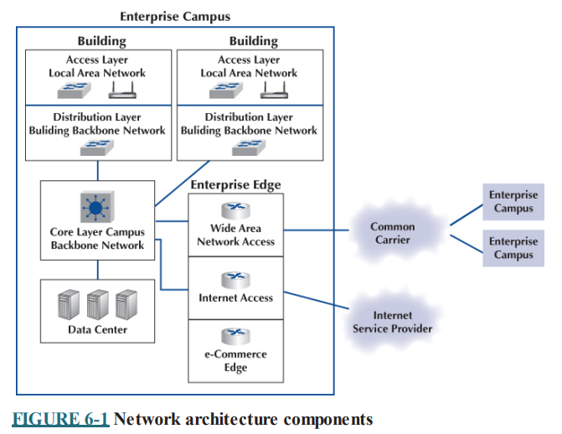
Network Architecture Components
Network designers usually think about networks as seven distinct network architecture components when they design networks. Figure shows a typical network for a large enterprise. This organization has three enterprise campuses in different cities that are connected by a WAN provided by a common carrier such as AT&T. Each campus has several buildings that are connected by a backbone network.

Slide 5
The first network architecture component is the local area network (LAN), which enables users to access the network. Some vendors call this component the access layer because it provides access to the network. LANs may be both wired and wireless, because when we build LANs today, we usually provide both wired and wireless access. The technologies we use in the LAN are probably familiar to you because you have used them, and perhaps you have even installed them in your home or apartment: They are network hubs, switches, and wireless access points.
The second network architecture component is the building backbone network, which some vendors call the distribution layer, because it distributes network traffic to and from the LANs. The building backbone typically uses the same basic technology that we use in the LAN (a network switch), but usually we buy faster switches because the building backbone carries more network traffic than a LAN.

Slide 6
The third network architecture component is the campus backbone (sometimes called the core layer), which connects all the buildings on one campus. The campus backbone is usually faster than the backbones we use inside buildings because it typically carries more traffic than they do. We use routers or layer 3 switches that do routing when we design the campus backbone.
The fourth network architecture component is the data center, which contains the organization’s servers (e.g., database servers, email servers). The data center is essentially a LAN, but because so much traffic goes to and from the data center, it is typically designed and managed very differently than the LANs intended for user access. The data center is usually located centrally on the enterprise campus, with a very, very-high-speed connection into the campus backbone. There is usually one primary data center for the organization, typically found on its main headquarters campus. It is common for large organizations to have several data centers spread around the world. Many enterprise campuses have their own smaller data centers that store data just for that campus.

Slide 7
The last three components of the network architecture make up the enterprise edge, the parts of the network that are at the edge of an enterprise campus and connect that campus to the rest of the world. One of these is the wide area network (WAN). A WAN is a private network that connects its different campus locations, usually leased from a common carrier such as AT&T. The WAN is for the private use of the organization and only carries its network traffic from one campus to another, unlike the Internet, which carries traffic from many different organizations. The circuits used in the WAN are traditionally very different than the Ethernet we use in the LAN, but this is changing.
Another network architecture component is the Internet access component, which enables the organization to connect to the Internet. The Internet and the technologies we use to connect to it. Large organizations use the same technologies to connect to the Internet as they use in the WAN. Small companies and individuals like us typically use cable modem from your cable company (e.g., Comcast or Time Warner) or DSL from AT&T.

Slide 8
The final network architecture component is the e-commerce edge. The ecommerce edge is a special LAN with a group of servers that enables electronic data exchange between the organization and the external entities with which it does business (such as its customers or suppliers). For example, the organization’s primary Web server is located in the e-commerce edge. Like the data center, the design of the LAN for the e-commerce edge is specialized.
Network design usually begins at the access layer, not the core layer. The needs of the users drive the network design (as well as the applications in the data center).
Most organizations put the last five components in the same building. The switches and routers that compose the campus backbone, the data center, and the enterprise edge are usually placed in one central building on campus so that data move very quickly between the enterprise edge, the campus backbone, and the data center.

Slide 9
The Traditional Network Design Process:
The traditional network design process follows a very structured systems analysis and design process similar to that used to build application systems.
First, the network analyst meets with users to identify user needs and the application systems planned for the network.
Second, the analyst develops a precise estimate of the amount of data that each user will send and receive and uses this to estimate the total amount of traffic on each part of the network.
Third, the circuits needed to support this traffic plus a modest increase in traffic are designed, and cost estimates are obtained from vendors. Finally, 1 or 2 years later, the network is built and implemented.
This traditional process, although expensive and time consuming, works well for static or slowly evolving networks. Unfortunately, networking today is significantly different from what it was when the traditional process was developed. Three forces are making the traditional design process less appropriate for many of today’s networks.

Slide 10
First, the underlying technology of the client and server computers, networking devices, and the circuits themselves is changing very rapidly. In the early 1990s, mainframes dominated networks, the typical client computer was an 8-MHz 386 with 1 megabyte (MB) of random access memory (RAM) and 40 MB of hard disk space, and a typical circuit was a 9,600-bps mainframe connection or a 1-Mbps LAN. Today, client computers and servers are significantly more powerful, and circuit speeds of 1 Gbps (one billion bits per second) are common. We now have more processing capability and network capacity than ever before; both are no longer scarce commodities that we need to manage carefully.
Second, the growth in network traffic is immense. The challenge is not in estimating today’s user demand but in estimating its growth rate. In the early 1990s, email and the Web were novelties primarily used by university professors and scientists. In the past, network demand was essentially driven by predictable business systems such as order processing. Today, much network demand is driven by less predictable user behavior, such as email and the Web.

Slide 11
Many experts expect the rapid increase in network demand to continue, especially as video, voice, and multimedia applications become commonplace on networks. At a 10% growth rate, user demand on a given network will increase by one-third in 3 years. At 20%, it will increase by about 75% in 3 years. At 30%, it will double in less than 3 years. A minor mistake in estimating the growth rate can lead to major problems. With such rapid growth, it is no longer possible to accurately predict network needs for most networks. In the past, it was not uncommon for networks to be designed to last for 5–10 years. Today, most network designers use a 3- to 5-year planning horizon.
Finally, the balance of costs has changed dramatically over the years. In the early 1990s, the most expensive item in any network was the hardware (circuits, devices, and servers). Today, the most expensive part of the network is the staff members who design, operate, and maintain it. As the costs have shifted, the emphasis in network design is no longer on minimizing hardware cost (although it is important); the emphasis today is on designing networks to reduce the staff time needed to operate them.

Slide 12
The traditional process minimizes the equipment cost by tailoring the equipment to a careful assessment of needs but often results in a mishmash of different devices with different capabilities. Two resulting problems are that staff members need to learn to operate and maintain many different devices and that it often takes longer to perform network management activities because each device may use slightly different software.
Today, the cost of staff time is far more expensive than the cost of equipment. Thus, the traditional process can lead to a false economy—save money now in equipment costs but pay much more over the long term in staff costs.

Slide 13
The Building-Block Network Design Process
Some organizations still use the traditional process of network design, particularly for those applications for which hardware or network circuits are unusually expensive (e.g., WANs that cover long distances through many different countries). However, many other organizations now use a simpler approach to network design that we call the building-block process. The key concept in the building-block process is that networks that use a few standard components throughout the network are cheaper in the long run than networks that use a variety of different components on different parts of the network.
Rather than attempting to accurately predict user traffic on the network and build networks to meet those demands, the building-block process instead starts with a few standard components and uses them over and over again, even if they provide more capacity than is needed. The goal is simplicity of design. This strategy is sometimes called “narrow and deep” because a very narrow range of technologies and devices is used over and over again (very deeply throughout the organization). The results are a simpler design process and a more easily managed network built with a smaller range of components.

Slide 14
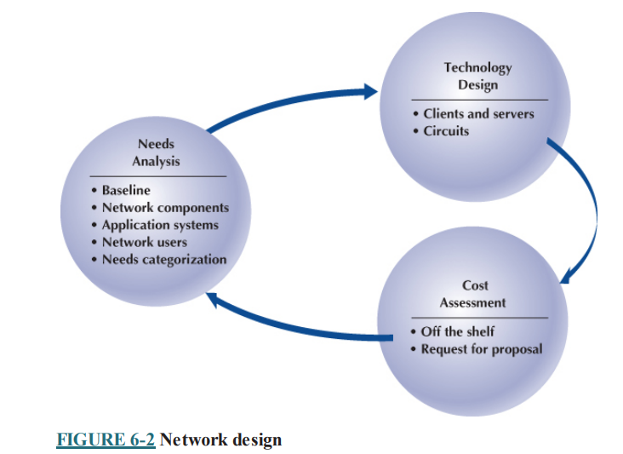

Slide 15
The basic design process involves three steps that are performed repeatedly: needs analysis, technology design, and cost assessment. This process begins with needs analysis, during which the designer attempts to understand the fundamental current and future network needs of the various users, departments, and applications. This is likely to be an educated guess at best. Users’ access needs and the needs of applications drive the network design process from the top into the center of the network. These needs are classified as typical or high volume. Specific technology needs are identified (e.g., the ability to dial in with current modem technologies).
The next step, technology design, examines the available technologies and assesses which options will meet users’ needs. The designer makes some estimates about the network needs of each category of user and circuit in terms of current technology (e.g., 1 Gbps Ethernet) and matches needs to technologies. Because the basic network design is general, it can easily be changed as needs and technologies change. The difficulty, of course, lies in predicting user demand so one can define the technologies needed. Most organizations solve this by building more capacity than they expect to need and by designing networks that can easily grow and then closely monitoring growth so they expand the network ahead of the growth pattern.

Slide 16
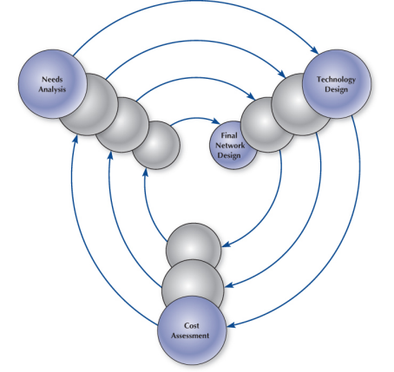
In the third step, cost assessment, the relative costs of the technologies are considered. The process then cycles back to the needs analysis, which is refined using the technology and cost information to produce a new assessment of users’ needs. This, in turn, triggers changes in the technology design and cost assessment, and so on.
By cycling through these three processes, the final network design is established.

Slide 17
Need Analysis
The goal of needs analysis is to understand why the network is being built and what users and applications it will support. In many cases, the network is being designed to improve poor performance or enable new applications to be used. In other cases, the network is upgraded to replace unreliable or aging equipment or to standardize equipment so that only one type of equipment, one protocol (e.g., TCP/IP, Ethernet), or one vendor’s equipment is used everywhere in the network.
Often, the goals in network design are slightly different between LANs and backbone networks (BNs) on the one hand and WANs on the other. In the LAN and BN environments, the organization owns and operates the equipment and the circuits. Once they are paid for, there are no additional charges for usage. However, if major changes must be made, the organization will need to spend additional funds. In this case, most network designers tend to be incorrect on the side of building too big a network—that is, building more capacity than they expect to need.

Slide 18
In contrast, in most WANs, the organization leases circuits from a common carrier and pays for them on a monthly or per-use basis. Understanding capacity becomes more important in this situation because additional capacity comes at a noticeable cost. In this case, most network designers tend to be incorrect on the side of building too small a network, because they can lease additional capacity if they need it—but it is much more difficult to cancel a long-term contract for capacity they are not using.
Much of the needs analysis may already have been done because most network design projects today are network upgrades rather than the design of entirely new networks. In this case, there is already a fairly good understanding of the existing traffic in the network and, most important, of the rate of growth of network traffic. It is important to gain an understanding of the current operations (application systems and messages). This step provides a baseline against which future design requirements can be gauged. It should provide a clear picture of the present sequence of operations, processing times, work volumes, the current communication network (if one exists), existing costs, and user/management needs. Whether the network is a new network or a network upgrade, the primary objective of this stage is to define (1) the geographic scope of the network and (2) the users and applications that will use it.

Slide 19
The goal of the needs analysis step is to produce a logical network design, which is a statement of the network elements needed to meet the needs of the organization. The logical design does not specify technologies or products to be used (although any specific requirements are noted). Instead, it focuses on the fundamental functionality needed, such as a high-speed access network, which in the technology design stage will be translated into specific technologies (e.g., switched 100Base-T).
Understanding Business Requirements
Determine the number of users, their roles, and the type of devices they will use to access the network.
Identify the applications critical to business operations, their bandwidth needs, and network latency tolerance.
Analyze the volume of data that needs to be transferred both internally and externally.
Consider future growth projections and design the network to be scalable to accommodate additional users and resources.

Slide 20
Security Requirements
Identify sensitive data that requires encryption and access control measures to comply with regulations and protect against unauthorized access.
Determine the level of firewall security and intrusion detection/prevention systema needed to safeguard against cyber threats.
Establish secure user authentication methods, such as multi-factor authentication, to control access to the network resources.
Performance and Bandwidth Requirements
Assess the bandwidth requirements of applications, ensuring that there is enough capacity to support seamless operation.
Determine the acceptable level of latency for real-time applications such as video conferencing or VoIP calls.
Identify applications that require prioritized network access and implement QoS policies accordingly.

Slide 21
Network Infrastructure
Specify the types of routers, switches, access points, and other networking hardware needed based on the organization's size and requirements.
Plan the physical layout, considering Ethernet, fiber optics, and wireless connectivity based on the office layout and environmental factors.
Disaster Recovery and Redundancy
Define data backup and disaster recovery strategies to ensure data integrity and availability in case of system failures or cyber-attacks.
Implement redundant components and connections to minimize downtime in case of hardware failures.
Compliance and Regulations:
Identify industry-specific regulations governing data storage, privacy, and network security. Ensure the network design complies with these regulations.
Establish policies for data retention and disposal to comply with legal requirements and protect sensitive information.

Slide 22
User Experience and Support
Plan training programs to educate users about network usage policies, security best practices, and basic troubleshooting techniques.
Develop procedures for handling user support requests, ensuring timely and efficient resolution of network-related issues.
Budget Constraints
Analyze the budget available for the network design and ensure that the proposed solution aligns with the financial constraints while meeting essential requirements.

Slide 23
Network Architecture Component
The first step in need analysis is to break the network into the seven network architecture components: LANs, building backbones, campus backbones, WANs, Internet access, e-commerce edge, and data centers. Not all layers are present in all networks. Small networks, for example, may not have a core backbone because there is only one building. Likewise, the data center is typically designed and managed separately.
Sometimes, the current network infrastructure imposes constraints. For example, if we are adding a new building to an existing office complex that used 1 Gbps Ethernet in the LANs, then we will probably choose to use the same in the new building. All such constraints are noted.
It is easiest to start with the highest level, so most designers begin by drawing a network diagram for any WANs with enterprise campuses that must be connected. A diagram that shows the logical network going between the locations is sufficient. Details such as the type of circuit and other considerations will be added later. Next, the individual enterprise campus diagrams are drawn, usually in a series of separate diagrams, but for a simple network, one diagram may be sufficient.

Slide 24
At this point, the designers gather general information and characteristics of the environment in which the network must operate. For example, they determine whether there are any legal requirements, such as local, state/provincial, federal, or international laws, regulations, or building codes, that might affect the network.

Slide 25
Application Systems
Next, the designers must review the list of applications that will use the network and identify the location of each. This information should be added to the emerging network documentation. This process is called baselining. Next, those applications that are expected to use the network in the future are added.
In many cases, the applications will be relatively well defined. Specific internal applications (e.g., payroll) and external applications (e.g., Web servers) may already be part of the “old” network. However, it is important to review the organization’s long-range and short-range plans concerning changes in company goals, strategic plans, development plans for new products or services, projections of sales, research and development projects, major capital expenditures, possible changes in product mix, new offices that must be served by the communications network, security issues, and future commitments to technology. For example, a major expansion in the number of offices or a major electronic commerce initiative will have a significant impact on network requirements.

Slide 26
It is also helpful to identify the hardware and software requirements of each application that will use the network and, if possible, the protocol each application uses (e.g., HTTP over TCP/IP, Windows file access). This knowledge helps now and will be particularly useful later when designers develop technological solutions.

Slide 27
Network Users
In the past, application systems accounted for the majority of network traffic. Today, much network traffic is produced by the discretionary use of the Internet. Applications such as email and the Web are generating significant traffic, so the network manager is no longer in total control of the network traffic generated on his or her networks. This is likely to continue in the future as network-hungry applications such as desktop videoconferencing become more common.
Therefore, in addition to understanding the applications, you must also assess the number and type of users that will generate and receive network traffic and identify their location on the emerging network diagram. We usually assume that most users will want both wired and wireless access to the network, although there are exceptions. Hotels may only provide wireless access for guests, and some offices may only provide wired access.

Slide 28
Categorizing Network Needs
At this point, the network has been designed in terms of geographic scope, application systems, and users. The next step is to assess the relative amount of traffic generated in each part of the network. With the traditional design approach, this involves considerable detailed analysis. With the building block approach, the goal is to provide some rough assessment of the relative magnitude of network needs.
Each application system is assessed in general terms to determine the amount of network traffic that can be expected to generate today and in the future, compared with other applications. Likewise, each user is categorized as either a typical user or a high-traffic user. These assessments will be refined in the next stage of the design process.
This assessment can be problematic, but the goal is some relative understanding of the network needs. Some simple rules of thumb can help. For example, applications that require large amounts of multimedia data or those that load executables over the network are likely to be high-traffic applications. Applications that are time sensitive or need constant updates (e.g., financial information systems, order processing) are likely to be high traffic applications.

Slide 29
Once the network requirements have been identified, they also should be organized into mandatory requirements, desirable requirements, and wish-list requirements. This information enables the development of a minimum level of mandatory requirements and a negotiable list of desirable requirements that are dependent on cost and availability. For example, desktop videoconferencing may be a wish-list item, but it will be omitted if it increases the cost of the network beyond what is desired.
At this point, the local facility network diagrams are prepared. For a really large network, there may be several levels. The choice is up to the designer, provided the diagrams and supporting text clearly explain the network’s needs.

Slide 30
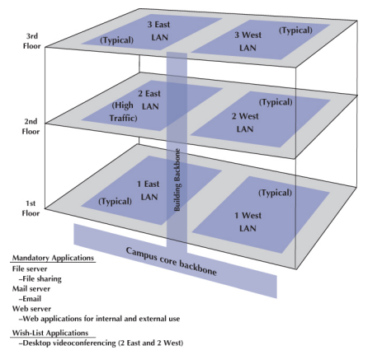
Deliverables
The key deliverable for the needs assessments stage is a set of logical network diagrams, showing the applications, circuits, clients, and servers in the proposed network, each categorized as either typical or high traffic. The logical diagram is the conceptual plan for the network and does not consider the specific physical elements (e.g., routers, switches, circuits) that will be used to implement the network. Figure shows the results of a needs assessment for a building that includes the access layer (LANs), the distribution layer (building backbone), and the core layer (campus backbone).

Slide 31
This figure shows the distribution and access components in the building with the series of six access LANs connected by one building backbone, which is in turn connected to a campus core backbone.
One of the six LANs is highlighted as a high-traffic LAN, whereas the others are typical ones. We normally would assume that the LANs need both wired and wireless access unless the requirements stated differently. Three mandatory applications are identified that will be used by all network users: email, Web, and file sharing. One wish-list requirement (desktop videoconferencing) is also identified for a portion of the network.

Slide 32
Technology Design
Once the needs have been defined in the logical network design, the next step is to develop a physical network design (or a set of possible designs). The physical network design starts with the client and server computers needed to support the users and applications. If the network is a new network, new computers will need to be purchased. If the network is an existing network, the servers may need to be upgraded to the newest technology. Once these are designed, then the circuits and devices connecting them are designed.
Designing Clients and Servers
The idea behind the building-block approach is to specify needs in terms of some standard units. Typical users are allocated the base-level client computers, as are servers supporting typical applications. Users and servers for applications needing more powerful computers are assigned some advanced computer. As the specifications for computers rapidly improve and costs drop (usually every 6 months), today’s typical user may receive the type of computer originally intended for the advanced user when the network is actually implemented, and the advanced users may end up with a computer not available when the network was designed.

Slide 33
Designing Circuits
The same is true for network circuits and devices (e.g., hubs, routers, switches). There are two interrelated decisions in designing network circuits and devices: the fundamental technology and protocols (e.g., Ethernet) and the capacity of each circuit (e.g., 100 Mbps, 1,000 Mbps). These are interrelated because each technology offers different circuit capacities.
Designing the circuit capacity means capacity planning, estimating the size and type of the standard and advanced network circuits for each type of network (LAN, backbone, WAN).
Designing circuit capacities for backbone networks is more challenging because backbones move traffic from many computers at one time and there are more choices in standard sizes. This requires some assessment of the current and future circuit loading (the amount of data transmitted on a circuit). This analysis can focus on either the average circuit traffic or the peak circuit traffic.
In any network, there may be a bottleneck, a circuit that is filled almost to its capacity and thus is the critical point that determines whether users get good or bad response times. When users complain about a slow network, it is usually because there is a bottleneck circuit somewhere in the network. Of course, the bottleneck could also be a slow Web server that is simply receiving more traffic than it can handle, but usually the problem is a circuit.

Slide 34
Network Design Tools
Network modeling and design tools can perform a number of functions to help in the technology design process. With most tools, the first step is to enter a diagram or model of the existing network or proposed network design. Some modeling tools require the user to create the network diagram from scratch. That is, the user must enter all of the network components by hand, placing each server, client computer, and circuit on the diagram and defining what each is.
Other tools can “discover” the existing network; that is, once installed on the network, they will explore the network to draw a network diagram. In this case, the user provides some starting point, and the modeling software explores the network and automatically draws the diagram itself. Once the diagram is complete, the user can then change it to reflect the new network design. Obviously, a tool that can perform network discovery by itself is most helpful when the network being designed is an upgrade to an existing network and when the network is very complex.

Slide 35
Once the diagram is complete, the next step is to add information about the expected network traffic and see if the network can support the level of traffic that is expected. Simulation, a mathematical technique in which the network comes to life and behaves as it would under real conditions, is used to model the behavior of the communication network. Applications and users generate and respond to messages while the simulator tracks the number of packets in the network and the delays encountered at each point in the network.
Simulation models may be tailored to the users’ needs by entering parameter values specific to the network at hand (e.g., this computer will send an average of three 100-byte packets per minute and receive one hundred 1,500- byte packets per minute). Alternatively, the user may prefer to rely primarily on the set of average values provided by the network.

Slide 36
Once the simulation is complete, the user can examine the results to see the estimated response times throughout. It is important to note that these network design tools provide only estimates, which may vary from the actual results. At this point, the user can change the network design in an attempt to eliminate bottlenecks and rerun the simulation. Good modeling tools not only produce simulation results but also highlight potential trouble spots (e.g., servers, circuits, or devices that experienced long response times). The very best tools offer suggestions on how to overcome the problems that the simulation identified.
There are several network design tools available that cater to different aspects of network planning. simulation, and visualization. These tools are essential for network architects and engineers to design, model, and analyze network configurations. Few popular network design tools are listed below:
Cisco Packet Tracer: Cisco Packet Tracer is a powerful network simulation tool that allows users to create network topologies, configure devices, and simulate network behavior. It is widely used for educational purposes and is especially useful for Cisco networking technologies.

Slide 37
Cisco VIRL (Virtual Internet Routing Lab): Cisco VIRL is a network design and simulation environment that provides a virtualized environment for designing, configuring, and testing complex network topologies. It supports various Cisco devices and allows for advanced simulations.
GNS3 (Graphical Network Simulator-3): GNS3 is an open-source network emulation software that allows users to create complex network topologies and run real operating systems. It supports Cisco, Juniper, and other vendors' devices and provides a flexible environment for testing and learning.
SolarWinds Network Configuration Manager:SolarWinds Network Configuration Manager is a network configuration management tool that helps automate configuration backups, change tracking, and compliance reporting. It is useful for managing configurations in large networks

Slide 38
Wireshark: Wireshark is a popular network protocol analyzer that allows users to capture and analyze network traffic in real time. It is widely used for troubleshooting network issues and understanding network behavior.
Microsoft Visio: Microsoft Visio is a diagramming tool that can be used for creating network diagrams, flowcharts, and visual representations of network architectures. It offers various templates for designing network layouts.
Draw.io: Draw.io is an online diagramming tool that supports creating network diagrams, flowcharts, and other visual representations. It offers a wide range of shapes and templates, making it suitable for network design.
Once the simulation is complete, the user can examine the results to see the estimated response times throughout. It is important to note that these network design tools provide only estimates, which may vary from the actual results. At this point, the user can change the network design in an attempt to eliminate bottlenecks and rerun the simulation. Good modeling tools not only produce simulation results but also highlight potential trouble spots (e.g., servers, circuits, or devices that experienced long response times). The very best tools offer suggestions on how to overcome the problems that the simulation identified.

Slide 39
Deliverables:
The key deliverable is a set of one or more physical network designs, which is the design for a single building. Most designers like to prepare several physical designs so they can trade-off technical benefits (e.g., performance) against cost. In most cases, the critical part is the design of the network circuits and devices. In the case of a new network designed from scratch, it is also important to define the client computers with care because these will form a large portion of the total cost of the network. Usually, however, the network will replace an existing network and only a few of the client computers in the existing network will be upgraded.

Slide 40
Cost Assessment
The purpose of this step is to assess the costs of various physical network design alternatives produced in the previous step. The main items are the costs of software, hardware, and circuits. These three factors are all interconnected and must be considered along with the performance and reliability required. All factors are interrelated with regard to cost. Estimating the cost of a network is quite complex because many factors are not immediately obvious. Some of the costs that must be considered are as follows:
Circuit costs, including costs of circuits provided by common carriers or the cost of purchasing and installing your own cable
Network devices such as switches and routers
Hardware costs, including servers, printers, uninterruptible power supplies, and backup tape drives
Software costs for network operating system, application software, and middleware
Network management costs, including special hardware, software, and training needed to develop a network management system for ongoing redesign, monitoring, and diagnosis of problems
Test and maintenance costs for special monitoring equipment and software, plus the cost of onsite spare parts
Costs for WAN and Internet circuits leased from common carriers

Slide 41
Request for Proposals:
Although some network components can be purchased off the shelf, most organizations develop a request for proposal (RFP) before making large network purchases. RFPs specify what equipment, software, and services are desired and ask vendors to provide their best prices. Some RFPs are very specific about what items are to be provided in what time frame. In other cases, items are defined as mandatory, important, or desirable, or several scenarios are provided and the vendor is asked to propose the best solution. In a few cases, RFPs specify generally what is required and the vendors are asked to propose their own network designs.

Slide 42
RFP Sample
Information in a Typical Request for Proposal Background information Organizational profile Overview of current network Overview of new network Goals of new network Network requirements Choice sets of possible network designs (hardware, software, circuits) Mandatory, desirable, and wish-list items Security and control requirements Response-time requirements Guidelines for proposing new network designs Service requirements Implementation time plan Training courses and materials Support services (e.g., spare parts on site) Reliability and performance guarantees
Bidding process Time schedule for the bidding process Ground rules Bid evaluation criteria Availability of additional information Information required from vendor Vendor corporate profile Experience with similar networks Hardware and software benchmarks Reference list

Slide 43
Selling the Proposal to Management:
One of the main problems in network design is obtaining the support of senior management. To management, the network is simply a cost center, something on which the organization is spending a lot of money with little apparent change. The network keeps on running just as it did the year before.
The key to gaining the acceptance of senior management lies in speaking management’s language. It is pointless to talk about upgrades from 100 Mbps to 1 Gbps on the backbone because this terminology is meaningless from a business perspective. A more compelling argument is to discuss the growth in network use. For example, a simple graph that shows network usage growing at 25% per year, compared with the network budget growing at 10% per year, presents a powerful illustration that the network costs are well managed, not out of control.
Likewise, a focus on network reliability is an easily understandable issue. For example, if the network supports a mission-critical system such as order processing or moving point-of-sale data from retail stores to corporate offices, it is clear from a business perspective that the network must be available and performing properly, or the organization will lose revenue.

Slide 44
Deliverables:
There are three key deliverables for this step. The first is an RFP that goes to potential vendors. The second deliverable, after the vendor has been selected, is the revised physical network diagram with the technology design complete. Exact products and costs are specified at this point (e.g., a 24-port 1000Base-T Cisco Ethernet switch). The third deliverable is the business case that provides support for the network design, expressed in business objectives.

Slide 45
Introduction to Network Management
Network management is the process of operating, monitoring, and controlling the network to ensure it works as intended and provides value to its users. The primary objective of the data communications function is to move application layer data from one location to another in a timely fashion and to provide the resources that allow this transfer to occur. This transfer of information may take place within a single department, between departments in an organization, or with entities outside the organization across private networks or the Internet.
Without a well-planned, well-designed network and without a well-organized network management staff, operating the network becomes extremely difficult. Unfortunately, many network managers spend most of their time firefighting— dealing with breakdowns and immediate problems. If managers do not spend enough time on planning and organizing the network and networking staff, which are needed to predict and prevent problems, they are destined to be reactive rather than proactive in solving problems.

Slide 46
Designing for Network Performance
Designing for network performance involves creating a network infrastructure that is optimized for speed, reliability, and efficiency. The key considerations to enhance network performance are:
Need Assessment
Bandwidth Planning
Network Topology
Invest in high performance routers, switches, and access points capable of handling the expected network traffic
Scalable Infrastructure
Cabling and Connectivity
Optimized Protocols
Network Security
Network Segmentation
Monitoring Analysis
Regular Maintenance
Plan for Scalability
Employee Training, etc.

Slide 47
Managed Networks:
Designing a managed network for optimal performance involves careful planning, strategic decision making, and ongoing maintenance. Managed networks, often overseen by Managed Service Provider (MSPs) or internal IT teams, require additional considerations to ensure efficiency, security, an scalability.
The single most important element that contributes to the performance of a network is a managed network that uses managed devices. Managed devices are standard devices, such as switches and routers, that have small onboard computers to monitor the traffic that flows through the device as well as the status of the device and other devices connected to it.
Managed devices perform their functions (e.g., routing, switching) and also record data on the traffic they process. These data can be sent to the network manager’s computer when the device receives a special control message requesting the data, or the device can send an alarm message to the network manager’s computer if it detects a critical situation such as a failing device or a huge increase in traffic.

Slide 48
In this way, network problems can be detected and reported by the devices themselves before problems become serious. In the case of the failing network card, a managed device could record the increased number of retransmissions required to successfully transmit messages and inform the network management software of the problem.
A managed switch is often able to detect the faulty transmissions from a failing network card, disable the incoming circuit so that the card could not send any more messages, and issue an alarm to the network manager. In either case, finding and fixing problems is much simpler, requiring minutes, not hours.
A managed network requires both hardware and software: managed devices (e.g., switches, routers, APs) to monitor, collect, and transmit traffic reports and problem alerts; and network management software to store, organize, and analyze these reports and alerts. Managed devices are more expensive than unmanaged devices because they have a CPU and software built into them. When we build a managed network, we normally buy all managed devices, rather than cutting costs by buying some managed devices and some unmanaged devices, although some organizations do install a mix of managed and unmanaged devices to cut costs. In this case, the managed devices are usually placed on the backbone and unmanaged devices in the access layer.

Slide 49
There are three fundamentally different types of network management software:
Device management software (sometimes called point management software) is designed to provide information about the specific devices on a network.
System management software (sometimes called enterprise management software or a network management framework) provides the same configuration, traffic, and error information as device management systems but can analyze the device information to diagnose patterns, not just display individual device problems.
Application management software also builds on the device management software, but instead of monitoring systems, it monitors applications.

Slide 50
Managing Network Traffic:
Most approaches to improving network performance attempt to maximize network speed. Another approach is to manage where and how we route traffic to improve network performance. There are two tools designed to better manage traffic with the ultimate goal of improving network performance:
Load Balancing
Policy Based Management

Slide 51
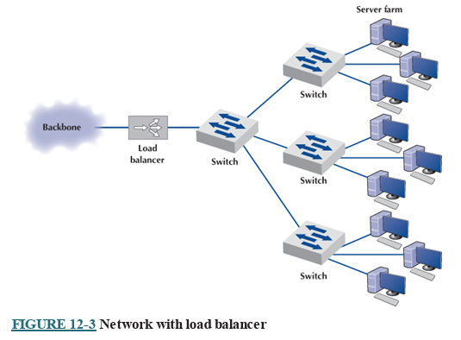
Load Balancing:
A special device called a load balancer or virtual server acts as a traffic manager at the front of the server farm. All requests are directed to the load balancer at its IP address. When a request hits the load balancer, it forwards it to one specific server using the server’s IP address. Sometimes a simple round-robin formula is used (requests go to each server one after the other in turn); in other cases, more complex formulas track how busy each server actually is. If a server crashes, the load balancer stops sending requests to it, and the network continues to operate without the failed server. Load balancing makes it simple to add servers (or remove servers) without affecting users. You simply add or remove the server(s) and change the software configuration in the load balancer; no one is aware of the change.

Slide 52
b. Policy-Based Management:
With policy-based management (sometimes called application shaping or traffic shaping), the network manager uses special software to set priority policies for network traffic that take effect when the network becomes busy. For example, the network manager might say that order processing and videoconferencing get the highest priority (order processing because it is the lifeblood of the company and videoconferencing because poor response time will have the greatest impact on it).
The policy management is usually implemented as a combination of hardware and software. A special device called a traffic shaper is installed at a key point (usually between a building backbone and the campus backbone). The software to manage this device also configures the network devices behind it using the quality of service (QoS) capabilities in TCP/IP and/or VLANs to give certain applications the highest priority when the devices become busy. Policy-based management requires managed devices that support QoS.

Slide 53
Reducing Network Traffic:
A more radical approach to improving performance is to reduce the amount of traffic on the network. We can’t reduce all types of network traffic, but if we limit high-capacity users and move the most commonly used data closer to the users who need it, we can reduce traffic enough to have an impact on network performance. This section discusses three different tools that can be used.
Capacity Management
Content Caching
Content Delivery

Slide 54
Capacity management:
Capacity management devices, sometimes called bandwidth limiter or bandwidth shapers, monitor traffic and can slow down traffic from users who consume a lot of network capacity. Capacity management is related to policy based management but is simpler in that it only looks at the source of the traffic (i.e., the source IP address) rather than the nature of the traffic (e.g., videoconferencing, email, Web pages). These devices are installed at key points in the network, such as between a backbone and the core network.

Slide 55
Content Caching:
The basic idea behind content caching is to store other people’s Web data closer to your users. With content caching, you install a content engine (also called a cache engine) close to your Internet connection and install special content management software on the router. The router directs all outgoing Web requests and the files that come back in response to those requests to the cache engine. The content engine stores the request and the static files that are returned in response (e.g., graphics files, banners). The content engine also examines each outgoing Web request to see if it is requesting static content that the content engine has already stored.
If the request is for content already in the content engine, it intercepts the request and responds directly itself with the stored file but makes it appear as though the request came from the URL specified by the user. The user receives a response almost instantaneously and is unaware that the content engine responded. The content engine is transparent.

Slide 56
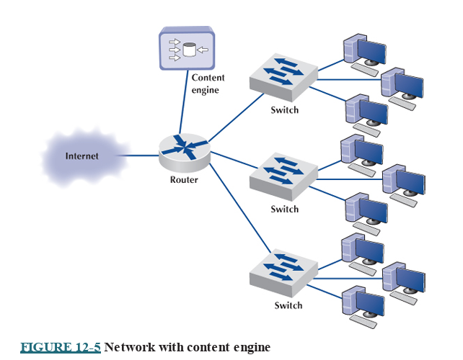
Although not all Web content will be in the content engine’s memory, content from many of the most commonly accessed sites on the Internet will be (e.g., yahoo.com, google.com, amazon.com). The contents of the content engine reflect the most common requests for each individual organization that uses it and changes over time as the pattern of pages and files changes. Each page or file also has a limited life in the cache before a new copy is retrieved from the original source so that pages that occasionally change will be accurate.

Slide 57
Content Delivery:
Content delivery, pioneered by Akamai, is a special type of Internet service that works in the opposite direction. Rather than storing other people’s Web files closer to their own internal users, a content delivery provider stores Web files for its clients closer to their potential users. Akamai, for example, operates almost 10,000 Web servers located near the busiest Internet IXPs and other key places around the Internet. These servers contain the most commonly requested Web information for some of the busiest sites on the Internet (e.g., yahoo.com, monster.com, ticketmaster.com).
When someone accesses a Web page of one of Akamai’s customers, special software on the client’s Web server determines if there is an Akamai server containing any static parts of the requested information (e.g., graphics, advertisements, banners) closer to the user. If so, the customer’s Web server redirects portions of the request to the Akamai server nearest the user. The user interacts with the customer’s website for dynamic content or HTML pages with the Akamai server providing static content.

Slide 58
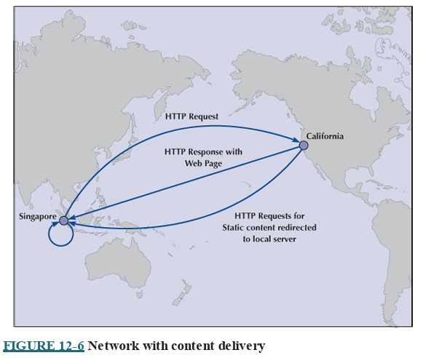
In figure, for example, when a user in Singapore requests a Web page from yahoo.com, the main yahoo.com server farm responds with the dynamic HTML page. This page contains several static graphic files. Rather than provide an address on the yahoo.com site, the Web page is dynamically changed by the Akamai software on the yahoo.com site to pull the static content from the Akamai server in Singapore. If you watch the bottom action bar closely on your Web browser while some of your favorite sites are loading, you’ll see references to Akamai’s servers. On any given day, 15–20% of all Web traffic worldwide comes from an Akamai server.
Akamai servers benefit both the users and the organizations that are Akamai’s clients, as well as many ISPs and all Internet users not directly involved with the Web request. Because more Web content is now processed by the Akamai server and not the client organization’s more distant Web server, the user benefits from a much faster response time

Slide 59
Configuration Management
Configuration management means managing the network’s hardware and software configuration, documenting it, and ensuring it is updated as the configuration changes.
Configuring the Network and Client Computers:
One of the most common configuration activities is adding and deleting user accounts. When new users are added to the network, they are usually categorized as being a member of some group of users (e.g., faculty, students, accounting department, personnel department). Each user group has its own access privileges, which define what file servers, directories, and files they can access and provide a standard log-in script. The log-in script specifies what commands are to be run when the user first logs in (e.g., setting default directories, connecting to public disks, running menu programs).
Another common activity is updating the software on the client computers attached to the network. Every time a new application system is developed or updated (or, for that matter, when a new version is released), each client computer in the organization must be updated. Traditionally, this has meant that someone from the networking staff has had to go to each client computer and manually install the software, either from CDs or by downloading over the network.

Slide 60
For a small organization, this is time consuming but not a major problem. For a large organization with hundreds or thousands of client computers (possibly with a mixture of Windows and Apples), this can be a nightmare.
Desktop management, sometimes called electronic software delivery or automated software delivery, is one solution to the configuration problem. Desktop management enables network managers to install software on client computers over the network without physically touching each client computer.
Desktop management greatly reduces the cost of configuration management over the long term because it eliminates the need to update each and every client computer manually. It also automatically produces and maintains accurate documentation of all software installed on each client computer and enables network managers to produce a variety of useful reports.

Slide 61
Documenting the Configuration:
Configuration documentation includes information about network hardware, network software, user and application profiles, and network documentation. The most basic information about network hardware is a set of network configuration diagrams that document the number, type, and placement of network circuits (whether organization owned or leased from a common carrier), network servers, network devices (e.g., hubs, routers), and client computers. For most organizations, this is a large set of diagrams: one for each LAN, BN, and WAN.
Documentation should include the type of device, serial number, vendor, date of purchase, warranty information, repair history, telephone number for repairs, and any additional information or comments the network manager wishes to add. For example, it would be useful to include contact names and telephone numbers for the individual network managers responsible for each separate LAN within the network and common carrier telephone contact information.

Slide 62
Software documentation can also help in negotiating site licenses for software. Many users buy software on a copy-by-copy basis, paying the retail price for each copy. It may be cheaper to negotiate the payment of one large fee for an unlimited-use license for widely used software packages instead of paying on a per-copy basis.
The another type of documentation is the user and application profiles, which should be automatically provided by the network operating system or additional vendor or third-party software agreements. These should enable the network manager to easily identify the files and directories to which each user has access and each user’s access rights (e.g., read-only, edit, delete). Equally important is the ability to access this information in the “opposite” direction, that is, to be able to select a file or directory and obtain a list of all authorized users and their access rights.
In addition, other documentation must be routinely developed and updated pertaining to the network. This includes network hardware and software manuals, application software manuals, standards manuals, operations manuals for network staff, vendor contracts and agreements, and licenses for software.

Slide 63
Performance and Fault Management
Performance management means ensuring the network is operating as efficiently as possible, whereas fault management means preventing, detecting, and correcting faults in the network circuits, hardware, and software (e.g., a broken device or improperly installed software). Fault management and performance management are closely related because any faults in the network reduce performance. Both require network monitoring, which means keeping track of the operation of network circuits and devices to ensure they are functioning properly and to determine how heavily they are used.
Network Monitoring
Most large organizations and many smaller ones use network management software to monitor and control their networks. One function provided by these systems is to collect operational statistics from the network devices. For small networks, network monitoring is often done by one person, aided by a few simple tools.

Slide 64
In large networks, network monitoring becomes more important. Large networks that support organizations operating 24 hours a day are often mission critical, which means a network problem can have serious business consequences. For example, consider the impact of a network failure for a common carrier such as AT&T or for the air traffic control system.
These networks often have a dedicated network operations center (NOC) that is responsible for monitoring and fixing problems. Such centers are staffed by a set of skilled network technicians that use sophisticated network management software. When a problem occurs, the software immediately detects the problems and sends an alarm to the NOC. Staff members in the NOC diagnose the problem and can sometimes fix it from the NOC (e.g., restarting a failed device). Other times, when a device or circuit fails, they must change routing tables to route traffic away from the device and dispatch a technician to fix it.
Some types of management software operate passively, collecting the information and reporting it back to the central NOC. Others are active, in that they routinely send test messages to the servers or application being monitored (e.g., an HTTP Web page request) and record the response times.

Slide 65
Performance tracking is important because it enables the network manager to be proactive and respond to performance problems before users begin to complain. Poor network reporting leads to an organization that is overburdened with current problems and lacks time to address future needs. Management requires adequate reports if it is to address future needs.
Failure Control Function:
Failure control requires developing a central control philosophy for problem reporting, whether the problems are first identified by the NOC or by users calling in to the NOC or a help desk. Whether problem reporting is done by the NOC or the help desk, the organization should maintain a central telephone number for network users to call when any problem occurs in the network. As a central troubleshooting function, only this group or its designee should have the authority to call hardware or software vendors or common carriers.
Many years ago, before the importance (and cost) of network management was widely recognized, most networks ignored the importance of fault management. Network devices were “dumb” in that they did only what they were designed to do (e.g., routing packets) but did not provide any network management information.

Slide 66
For example, suppose a network interface card fails and begins to transmit garbage messages randomly. Network performance immediately begins to deteriorate because these random messages destroy the messages transmitted by other computers, which need to be retransmitted. Users notice a delay in response time and complain to the network support group, which begins to search for the cause. Even if the network support group suspects a failing network card (which is unlikely, unless such an event has occurred before), locating the faulty card is very difficult and time consuming.
Most network managers today are installing managed devices that perform their functions (e.g., routing, switching) and also record data on the messages they process. Finding and fixing the fault is much simpler, requiring minutes, not hours.
Numerous software packages are available for recording fault information. The reports they produce are known as trouble tickets. The software packages assist the help desk personnel so they can type the trouble report immediately into a computerized failure analysis program.
Problem tracking allows the network manager to determine who is responsible for correcting any outstanding problems.

Slide 67
Problem statistics are important because they are a control device for the network managers as well as for vendors. With this information, a manager can see how well the network is meeting the needs of end users.
Problem prioritizing helps ensure that critical problems get priority over less important ones.
Management reports are required to determine network availability, product and vendor reliability (mean time between failures), and vendor responsiveness.
Performance and Failure Statistics:
Many different types of failure and recovery statistics can be collected. The most obvious performance statistics are those discussed earlier: how many packets are being moved on what circuits and what the response time is. Failure statistics also tell an important story.
One important failure statistic is availability, the percentage of time the network is available to users. It is calculated as the number of hours per month the network is available divided by the total number of hours per month (i.e., 24 hours per day × 30 days per month = 720 hours).

Slide 68

The downtime includes times when the network is unavailable because of faults and routine maintenance and network upgrades. Most network managers strive for 99 99.5% availability, with downtime scheduled after normal working hours.
The mean time between failures (MTBF) is the number of hours or days of continuous operation before a component fails. Obviously, devices with higher MTBF are more reliable.
When faults occur, and devices or circuits go down, the mean time to repair (MTTR) is the average number of minutes or hours until the failed device or circuit is operational again. The MTTR is composed of these separate elements:

Slide 69
The mean time to diagnose (MTTD) is the average number of minutes until the root cause of the failure is correctly diagnosed. This is an indicator of the efficiency of problem management personnel in the NOC or help desk who receive the problem report.
The mean time to respond (MTTR) is the average number of minutes or hours until service personnel arrive at the problem location to begin work on the problem. This is a valuable statistic because it indicates how quickly vendors and internal groups respond to emergencies. Compilation of these figures over time can lead to a change of vendors or internal management policies or, at the minimum, can exert pressure on vendors who do not respond to problems promptly.
Finally, after the vendor or internal support group arrives on the premises, the last statistic is the mean time to fix (MTTF). This figure tells how quickly the staff is able to correct the problem after they arrive.

Slide 70
For example, suppose your Internet connection at home stops working. You call your ISP, and they fix it over the phone in 15 minutes. In this case, the MTTRepair is 15 minutes, and it is hard to separate the different parts (MTTD, MTTR, and MTTF). Suppose you call your ISP and spend 60 minutes on the phone with them, and they can’t fix it over the phone; instead, the technician arrives the next day (18 hours later) and spends 1 hour fixing the problem. In this case, MTTR = 1 hour + 18 hours + 1 hour = 20 hours.
Improving Performance:
Most organizations establish service-level agreements (SLAs) with their common carriers and Internet service providers. An SLA specifies the exact type of performance and fault conditions that the organization will accept. For example, the SLA might state that network availability must be 99% or higher and that the MTBF for T1 circuits must be 120 days or more. In many cases, SLA includes maximum allowable response times. The SLA also states what compensation the service provider must provide if it fails to meet the SLA. Some organizations are also starting to use an SLA internally to define relationships between the networking group and its organizational “customers.”

Slide 71
End User Support
Providing end user support means solving whatever problems users encounter while using the network. There are three main functions within end user support: resolving network faults, resolving user problems, and training. We have already discussed how to resolve network faults, and now we focus on resolution of user problems and end user training.
Resolving Problems:
Problems with user equipment (as distinct from network equipment) usually stem from three major sources. The first is a failed hardware device. These are usually the easiest to fix. A network technician simply fixes the device or installs a new part.
The second type of problem is a lack of user knowledge. These problems can usually be solved by discussing the situation with the user and taking that person through the process step by step. This is the next easiest type of problem to solve and can often be done by email or over the telephone, although not all users are easy to work with. Problematic users are sometimes called ID ten-T errors, written ID10T.

Slide 72
The third type of problem is one with the software, software settings, or an incompatibility between the software and network software and hardware. In this case, there may be a bug in the software, or the software may not function properly on a certain combination of hardware and software. Solving these problems may be difficult because they require expertise with the specific software package in use and sometimes require software upgrades from the vendor.
Resolving either type of software problem begins with a request for assistance from the help desk. Requests for assistance are usually handled in the same manner as network faults. A trouble log is maintained to document all incoming requests and the manner in which they are resolved. The staff member receiving the request attempts to resolve the problem in the best manner possible. Staff members should be provided with a set of standard procedures or scripts for soliciting information from the user about problems. In large organizations, this process may be supported by special software.

Slide 73
There are often several levels to the problem-resolution process.
The first level is the most basic. All staff members working at the help desk should be able to resolve most of these. Most organizations strive to resolve between 75% and 85% of requests at this first level in less than an hour.
If the request cannot be resolved, it is escalated to the second level of problem resolution. Escalation is a normal part of the process and not something that is “bad.” Staff members who handle second-level support have specialized skills in certain problem areas or with certain types of software and hardware. In most cases, problems are resolved at this level.
Some large organizations also have a third level of resolution in which specialists spend many hours developing and testing various solutions to the problem, often in conjunction with staff members from the vendors of network software and hardware.

Slide 74
Providing End User Training
End user training is an ongoing responsibility of the network manager. Training is a key part in the implementation of new networks or network components. It is also important to have an ongoing training program because employees may change job functions and new employees require training to use the organization’s networks.
Training usually is conducted through in-class, one-on-one instruction and online self-paced courses. In-class training should focus on the 20% of the network functions that the user will use 80% of the time instead of attempting to cover all network functions. By getting in-depth instruction on the fundamentals, users become confident about what they need to do. The training should also explain how to locate additional information from online support, documentation, or the help desk.

Slide 75
Cost Management
The cost management in network management involves optimizing the expenses associated with designing, implementing, operating, and maintaining a computer network. It is the one of the most challenging areas of network management over the past few years has been cost management.
Data traffic has been growing much more rapidly than has the network management budget, which has forced network managers to provide greater network capacity at an ever-lower cost per megabyte.

Slide 76
Sources of Costs:
The cost of operating a network in a large organization can be very expensive. The total cost of ownership (TCO) is a measure of how much it costs per year to keep one computer operating. TCO includes the actual direct cost of repair parts, software upgrades, and support staff members to maintain the network, install software, administer the network (e.g., create user IDs, back up user data), provide training and technical support, and upgrade hardware and software.
It also includes the indirect cost of time "wasted" by the user when problems occur, when the network is down, or when the user is attempting to learn new software.
Network managers usually find it difficult to manage their budgets because networks grow so rapidly. They often find themselves having to defend ever-increasing requests for more equipment and staff. To counter these escalating costs, many large organizations have adopted charge-back policies for users of WANs and mainframe-based networks. (A charge-back policy attempts to allocate the costs associated with the network to specific users.)
These users must "pay" for their network usage by transferring part of their budget allocations to the network group. Such policies are seldom used in LANs, making one more potential cultural difference between network management styles.

Slide 77
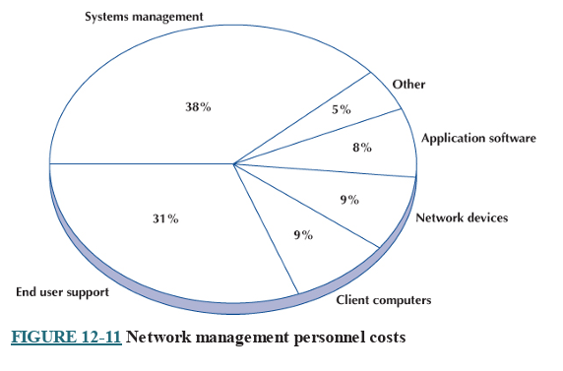
Figure shows the average breakdown of personnel costs by function. The largest time cost (where staff members spend most of their time) is systems management, which includes configuration, fault, and performance management tasks that focus on the network as a whole. The second largest item is end user support.

Slide 78
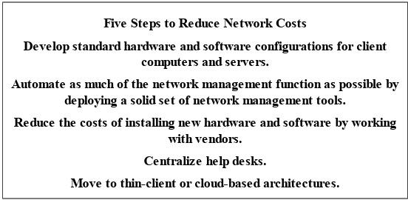
Reducing Costs
Given the huge amounts in TCO or even the substantial amounts spent in NCO, there is considerable pressure on network managers to reduce costs.
Five steps to reduce network costs.

Slide 79
The first and most important step is to develop standards for client computers, servers, and network devices (i.e., switches, routers). These standards define one configuration (or a small set of configurations) that are permitted for all computers and devices. Standardizing hardware and software makes it easier to diagnose and fix problems. Also, there are fewer software packages for the network support staff members to learn. The downside, of course, is that rigid adherence to standards reduces innovation.
The second most important step is to automate as much of the network management process as possible. Desktop management can significantly reduce the cost to upgrade when new software is released. It also enables faster installation of new computers and faster recovery when software needs to be reinstalled and helps enforce the standards policies. The use of network management software to identify and diagnose problems can significantly reduce time spent in performance and fault management. Likewise, help desk software can cut the cost of the end support function.
A third step is to do everything possible to reduce the time spent installing new hardware and software. The cost of a network technician’s spending half a day to install and configure new computers is often $300–$500. Desktop management is an important step to reducing costs, but careful purchasing can also go a long way. The installation of standard hardware and software (e.g., Microsoft Office) by the hardware vendor can significantly reduce costs. Likewise, careful monitoring of hardware failures can quickly identify vendors of less reliable equipment who should be avoided in the next purchasing cycle.

Slide 80
Traditionally, help desks have been decentralized into user departments. The result is a proliferation of help desks and support staff members, many of whom tend to be generalists rather than specialists in one area. Many organizations have found that centralizing help desks enables them to reduce the number of generalists and provide more specialists in key technology areas. This results in faster resolution of difficult problems. Centralization also makes it easier to identify common problems occurring in different parts of the organization and take actions to reduce them.
Finally, many network experts argue that moving to thin-client or cloud-based architectures, just Web browsers on the client, can significantly reduce costs. Although this can reduce the cost to buy software, the real saving lies in the support costs. Because they are restricted to a narrow set of functions and generally do not need software installations, thin client architectures become much easier to manage. TCO and NCO drop by 20–40%. Most organizations anticipate using thin-client and cloud-based architectures selectively in areas where applications are well defined and can easily be restricted.

